Slide 1
Spatiotemporal patterns in a porous catalyst
Richard Herz
Laura Carrington
University of California, San Diego
UCSD

Slide 2
Gradients in Porous Catalysts
Composition
Thermal
Especially under dynamic conditions!

Slide 3
How to measure?
Single Pellet Diffusion Reactor at steady state, Petersen and students
Thermocouples in pellet, Butt and students
Related - infrared imaging parallel to pellet surface

Slide 4
Dynamic Diffusion Reactor
Miniaturize single pellet diffusion reactor
Minimize time constants
Measure composition continuously

Slide 5
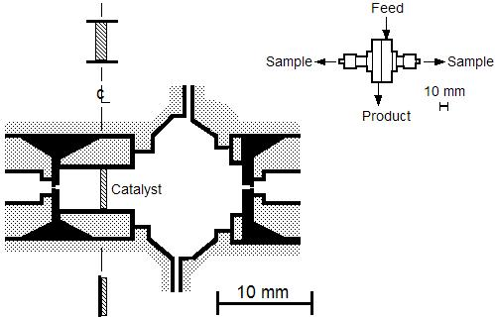
Dynamic Diffusion Reactor

Slide 6
DDR - Types of Experiments
Inert response →
diffusion coefficients
Single species response →
adsorption coefficients
Reaction response →
reaction-diffusion model

Slide 7
DDR - Approach
Measure concentration gradients
Model with detailed kinetics
CO + S → S-CO
O₂ + 2S’ → 2 S’-O
S-CO + S’-O → S + S’ + CO₂
over multiple site types, don’t assume adsorption equilibrium or rate-limiting step
R. Herz & S. Marin, J.Catal. 65, 281 (1980)
Fit model to experiments
Perform numerical experiments…

Slide 8
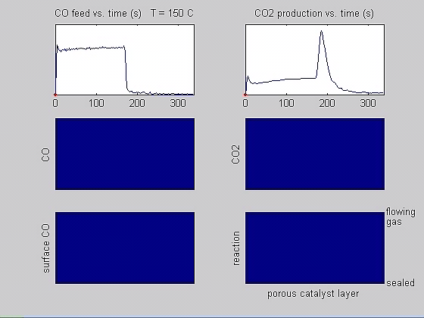
Step Responses
avi
qt

Slide 9
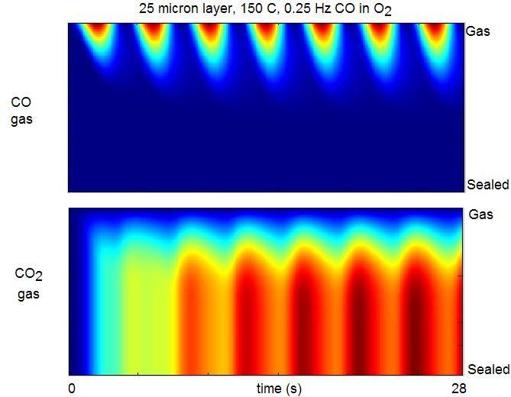
Cycling

Slide 10
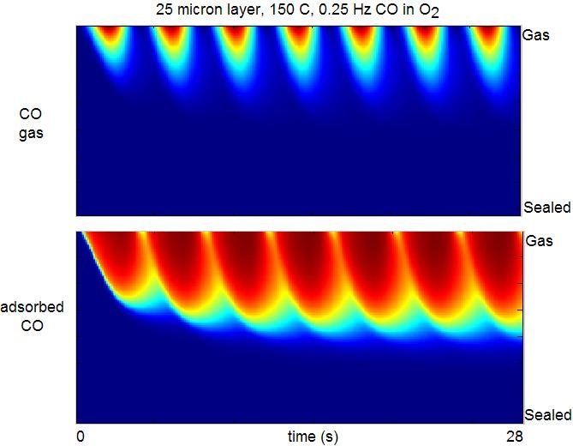
Cycling

Slide 11
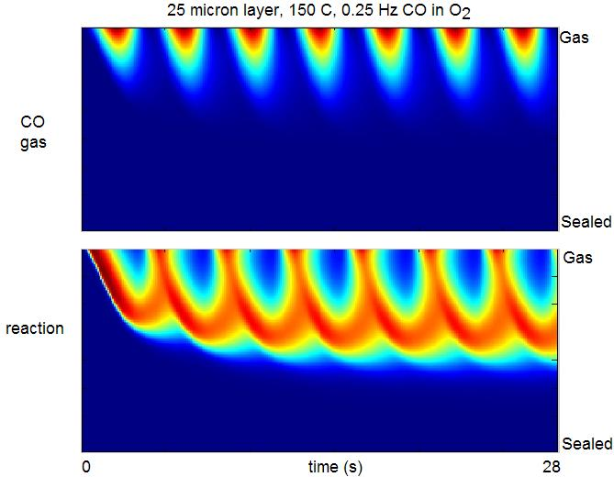
Cycling

Slide 12

Cycling

Slide 13
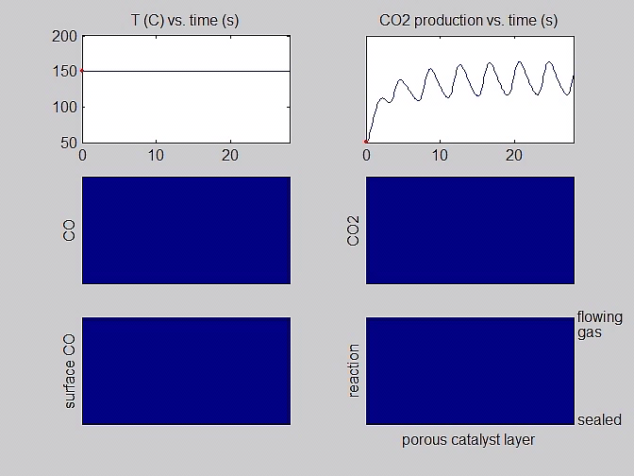
Cycling
avi
qt

Slide 14
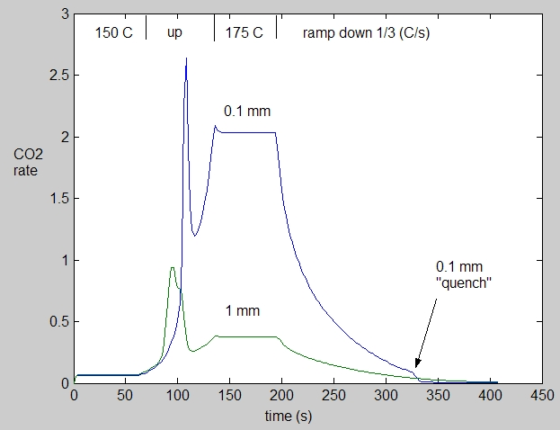
Temperature ramps

Slide 15
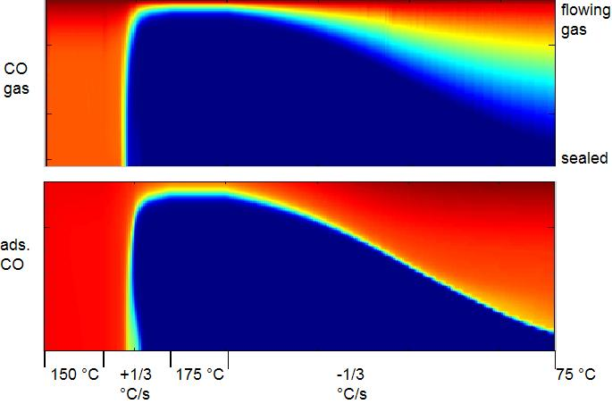
Temperature Ramps
1 mm layer

Slide 16
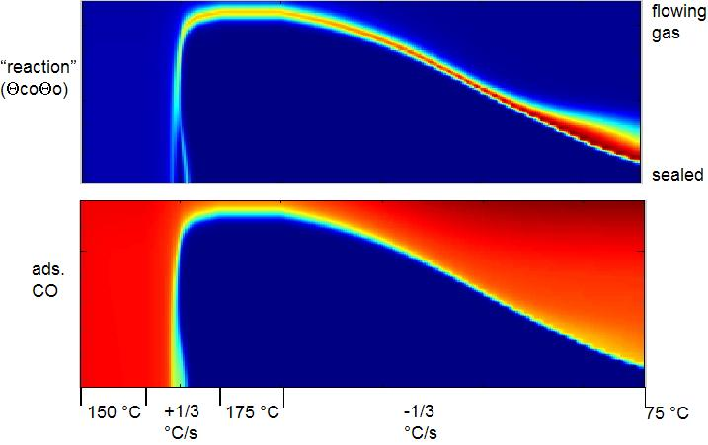
Temperature Ramps
1 mm layer

Slide 17
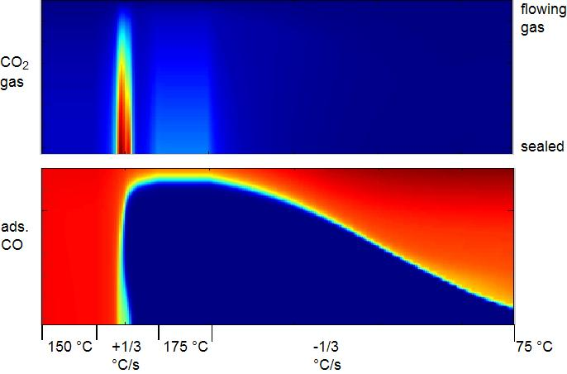
Temperature Ramps
1 mm layer

Slide 18
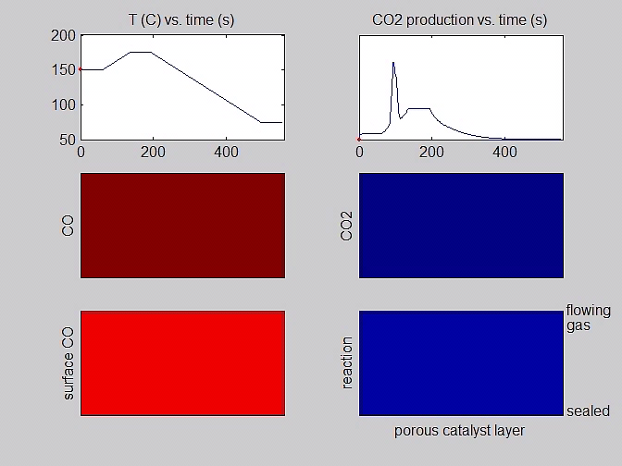
Temperature Ramps
1 mm layer
avi
qt

Slide 19
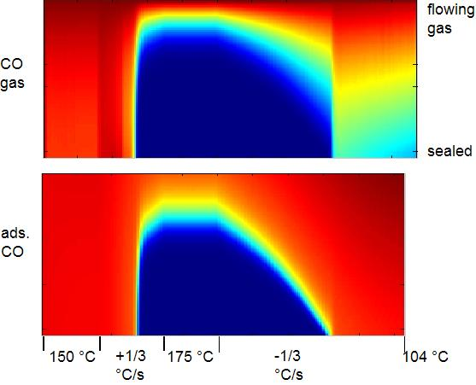
Temperature Ramps
0.1 mm layer

Slide 20
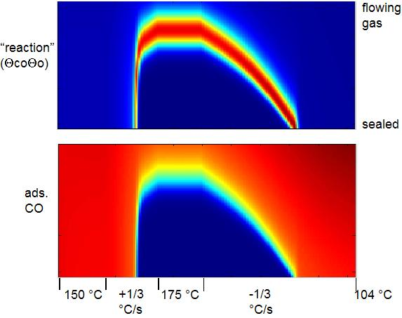
Temperature Ramps
0.1 mm layer

Slide 21
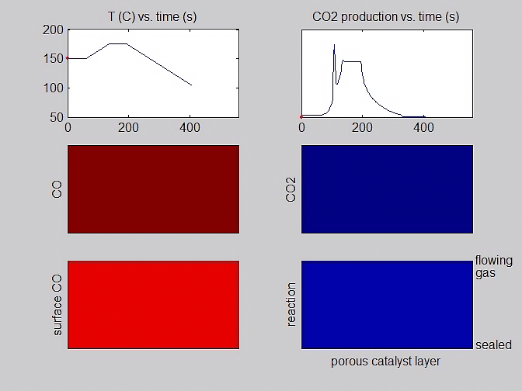
Temperature Ramps
0.1 mm layer
avi
qt

Slide 22
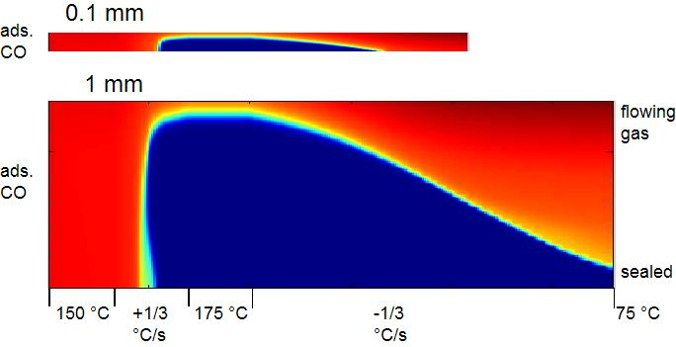
Temperature Ramps

Slide 23
Temperature Ramps
At constant total Pt, the following increase as catalyst thickness decreases:
  overall reaction rate
  “light off” temperature
  “quench” temperature
Thus, the catalyst is more active but over a narrow temperature range.

Slide 24
Temperature Ramps
Patterns change with catalyst thickness:
1 mm – double reaction fronts move from
center on “light-off”
0.1 mm – reaction “quenches” as CO front
reaches center
0.06 mm – CO gas peaks in center, reaction
front starts at exterior

Slide 25
Spatiotemporal Patterns
See the patterns and movies beginning next week at
www.reactorlab.net
Questions?
herz@reactorlab.net

